Slide 1
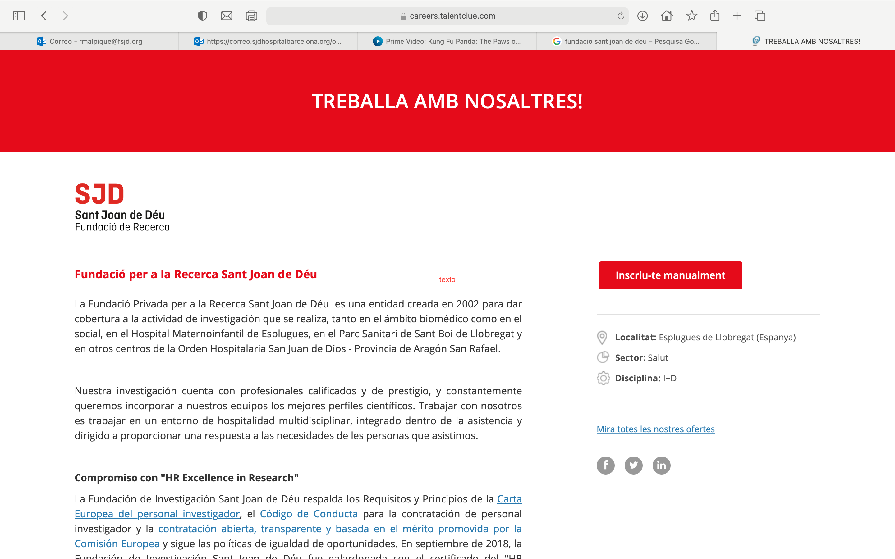





XXI Encuentro de Cooperación Farma-Biotech
17 de noviembre de 2021
SPIOMET: low-dose combination of 3 compounds in a single pill for treating PCOS
Prof. Lourdes Ibáñez
Prof. Francis de Zegher

Slide 2
XXI Encuentro de Cooperación Farma-Biotech
Agenda
Institutions
Product
  Targeted indication
  Mechanisms of action
  Differentiating features
  Status of development
  Intellectual property
  Pitfalls & risks
Partnering opportunities

Slide 3
XXI Encuentro de Cooperación Farma-Biotech
Agenda
Institutions
Product
  Targeted indication
  Mechanisms of action
  Differentiating features
  Status of development
  Intellectual property
  Pitfalls & risks
Partnering opportunities
# 1 tertiary pediatric center in Spain
# 1 innovative university in Europe

Slide 4
XXI Encuentro de Cooperación Farma-Biotech
Agenda
Institutions
Product
  Targeted indication
  Mechanisms of action
  Differentiating features
  Status of development
  Intellectual property
  Pitfalls & risks
Partnering opportunities
SPIOMET
a low-dose combination of
spironolactone, pioglitazone & metformin
for once-daily intake, in the evening
Apparently old & simple,
surprisingly young & complex

Slide 5
XXI Encuentro de Cooperación Farma-Biotech
Agenda
Institutions
Product
  Targeted indication
  Mechanisms of action
  Differentiating features
  Status of development
  Intellectual property
  Pitfalls & risks
Partnering opportunities
PCOS
Polycystic Ovary Syndrome
~10% of adolescent girls & young women
Key features:
  Hirsutism due to androgen excess
  Menstrual irregularity due to low ovulation rate
No treatment approved by either EMA or FDA
Consequence of ectopic fat accumulation, notably in liver
Future of PCOS treatment = early reduction of ectopic fat

Slide 6
XXI Encuentro de Cooperación Farma-Biotech
Agenda
Institutions
Product
  Targeted indication
  Mechanisms of action
  Differentiating features
  Status of development
  Intellectual property
  Pitfalls & risks
Partnering opportunities
SPIOMET
innovative complexity behind apparent simplicity
  Based on new concept: ectopic adiposity → PCOS
  None of the 3 compounds has been licensed for PCOS
  Each of the 3 compounds in unusually low & safe dose
  Combination of newly discovered mechanisms (2019-20)
    Activation of brown adipose tissue (spironolactone)
    Doubling of HMW adiponectinemia (pioglitazone)
    Tripling of circulating GDF15 (metformin)

Slide 7
XXI Encuentro de Cooperación Farma-Biotech
Agenda
Institutions
Product
  Targeted indication
  Mechanisms of action
  Differentiating features
  Status of development
  Intellectual property
  Pitfalls & risks
Partnering opportunities
SPIOMET
innovative complexity behind apparent simplicity
SPIOMET is the sole pharmacological treatment targeting
the root cause (= ectopic fat) without changing body weight.
Traditional off-label treatment with an oral contraceptive (OC) targets only downstream symptoms, and is thus followed by
a rebound of androgen excess & by a low ovulation rate.

Slide 8
XXI Encuentro de Cooperación Farma-Biotech
Agenda
Institutions
Product
  Targeted indication
  Mechanisms of action
  Differentiating features
  Status of development
  Intellectual property
  Pitfalls & risks
Partnering opportunities
OC vs SPIOMET in adolescent PCOS (N=62; age ~16 yr)
more normal liver fat → more normal ovulation rate
Annualized
Post-Treatment
Number of Ovulations
OC
3.6
9.9
SPIOMET
On Treatment
Post Treatment
J Endocr Soc, 2020
Hepatology, 2021

Slide 9
XXI Encuentro de Cooperación Farma-Biotech
Agenda
Institutions
Product
  Targeted indication
  Mechanisms of action
  Differentiating features
  Status of development
  Intellectual property
  Pitfalls & risks
Partnering opportunities
SPIOMET
EMA: approved Paediatric Investigation Plan (PIP)
    Adolescent girls & young women (12-24 yr)
    Acknowledgement of unmet medical need
    Acknowledgement of proof of concept
    No need for formulation development
    No need for pre-clinical studies
    No need for PK studies
    Approved Phase 2b design + H2020 funding*
    Subsequent need for (small) Phase 3 studies

Slide 10
XXI Encuentro de Cooperación Farma-Biotech
Agenda
Institutions
Product
  Targeted indication
  Mechanisms of action
  Differentiating features
  Status of development
  Intellectual property
  Pitfalls & risks
Partnering opportunities
Horizon 2020 project: SPIOMET4HEALTH
www.spiomet4health.eu
    Led by Lourdes Ibáñez & Francis de Zegher
    European consortium of leading PCOS centers
    Study design:
      Adolescent PCOS (12 – 24 yr); N=364
      Randomized, double-blind, single tablet
      Primary endpoint: ovulation rate
      4 groups: Placebo, PIO, SPIO, SPIOMET
    Key results available by 2025-26

Slide 11
XXI Encuentro de Cooperación Farma-Biotech
Agenda
Institutions
Product
  Targeted indication
  Mechanisms of action
  Differentiating features
  Status of development
  Intellectual property
  Pitfalls & risks
Partnering opportunities
SPIOMET for PCOS: patent status
  IP managed by Leuven Research & Development
  Patents granted in 2021
    EU & UK (EP3368044)
    Russia
    Mexico
    Australia
    (USA)
  Active patent applications worldwide

Slide 12
XXI Encuentro de Cooperación Farma-Biotech
Agenda
Institutions
Product
  Targeted indication
  Mechanisms of action
  Differentiating features
  Status of development
  Intellectual property
  Pitfalls & risks
Partnering opportunities
SPIOMET for PCOS: risks
  Phase 2b: results not available yet
  Beyond phase 2b:
    Obese patients: weight loss treatment (GLP-1)
    Non-obese patients: no competition in sight …

Slide 13
XXI Encuentro de Cooperación Farma-Biotech
Agenda
Institutions
Product
  Targeted indication
  Mechanisms of action
  Differentiating features
  Status of development
  Intellectual property
  Pitfalls & risks
Partnering opportunities
SPIOMET for PCOS: partnering opportunities
We are looking for a pharmaceutical partner
keen to advance SPIOMET beyond Phase 2b.

Slide 14
XXI Encuentro de Cooperación Farma-Biotech
Agenda
Institutions
Product
  Targeted indication
  Mechanisms of action
  Differentiating features
  Status of development
  Intellectual property
  Pitfalls & risks
Partnering opportunities
Thank You !

